Slide 1
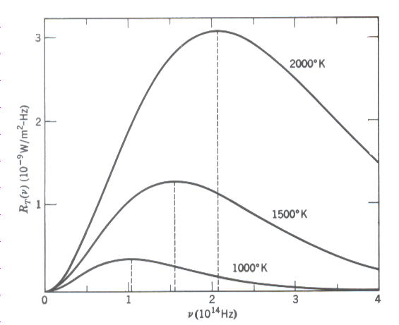
Chapter 1 Thermal radiation and Planck’s postulate
FUNDAMENTAL CONCEPTS OF QUANTUM PHYSICS
Thermal radiation: The radiation emitted by a body as a result of temperature.
Blackbody : A body that surface absorbs all the thermal radiation incident on
them.
Spectral radiancy : The spectral distribution of blackbody radiation.
represents the emitted energy from a unit area per unit time between and at absolute temperature T.
1899 by Lummer and Pringsheim

Slide 2
Chapter 1 Thermal radiation and Planck’s postulate
The spectral radiancy of blackbody radiation shows that:
(1) little power radiation at very low frequency
(2) the power radiation increases rapidly as ν increases from very
small value.
(3) the power radiation is most intense at certain for particular
temperature.
drops slowly, but continuously as ν increases
, and
increases linearly with increasing temperature.
(6) the total radiation for all ν ( radiancy )
increases less rapidly than linearly with increasing temperature.

Slide 3
Chapter 1 Thermal radiation and Planck’s postulate
Stefan’s law (1879):
Stefan-Boltzmann constant
Wien’s displacement (1894):
1.3 Classical theory of cavity radiation
Rayleigh and Jeans (1900):
(1) standing wave with nodes at the metallic surface
(2) geometrical arguments count the number of standing waves
(3) average total energy depends only on the temperature
one-dimensional cavity:
one-dimensional electromagnetic standing wave

Slide 4
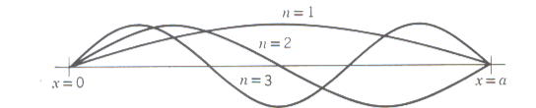
Chapter 1 Thermal radiation and Planck’s postulate
for all time t, nodes at
standing wave
the number of allowed standing wave between ν and ν+dν
two polarization states

Slide 5
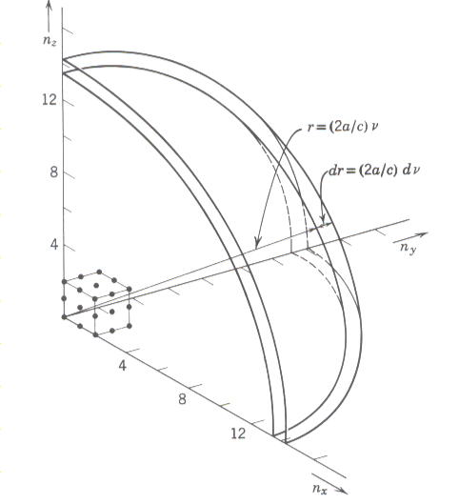
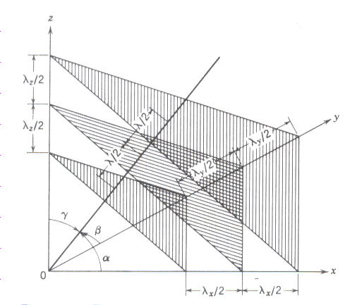
Chapter 1 Thermal radiation and Planck’s postulate
for three-dimensional cavity
the volume of concentric shell
The number of allowed electromagnetic standing wave in 3D
Proof:
propagation direction
λ/2
nodal planes
λ/2

Slide 6
Chapter 1 Thermal radiation and Planck’s postulate
for nodes:
considering two polarization state
Density of states per unit volume per unit frequency

Slide 7
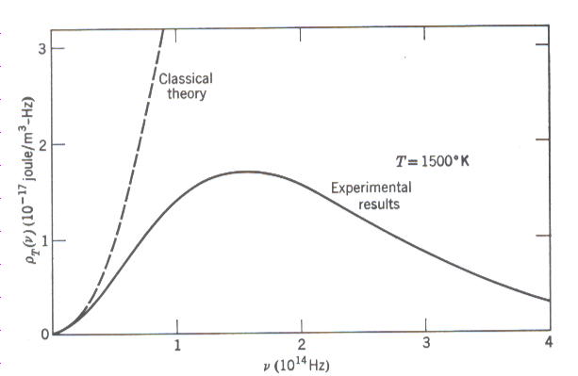
Chapter 1 Thermal radiation and Planck’s postulate
the law of equipartition energy:
For a system of gas molecules in thermal equilibrium at temperature T,
the average kinetic energy of a molecules per degree of freedom is kT/2,
is Boltzmann constant.
average total energy of each standing wave :
the energy density between ν and ν+dν:
Rayleigh-Jeans blackbody radiation
ultraviolet catastrophe

Slide 8
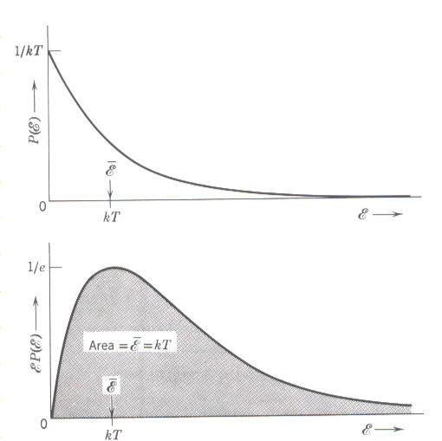
Chapter 1 Thermal radiation and Planck’s postulate
1.4 Planck’s theory of cavity radiation
Planck’s assumption: and
the origin of equipartition of energy:
Boltzmann distribution
probability of finding a system with energy between ε and ε+dε

Slide 9
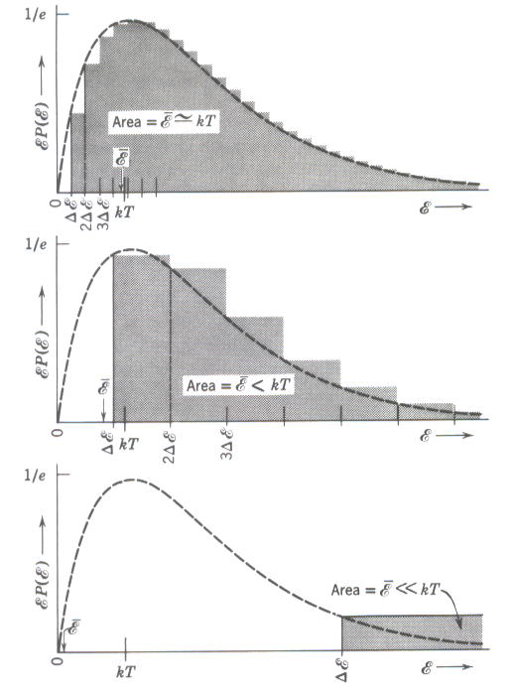
Chapter 1 Thermal radiation and Planck’s postulate
Planck’s assumption:
(1) small ν
(2) large large ν
Planck constant
Using Planck’s discrete energy to find

Slide 10
Chapter 1 Thermal radiation and Planck’s postulate

Slide 11
Chapter 1 Thermal radiation and Planck’s postulate
energy density between ν and ν+dν:
Ex: Show
solid angle expanded by dA is
spectral radiancy:

Slide 12
Chapter 1 Thermal radiation and Planck’s postulate
Ex: Use the relation between spectral radiancy
and energy density, together with Planck’s radiation law, to derive
Stefan’s law

Slide 13
Chapter 1 Thermal radiation and Planck’s postulate
Ex: Show that
Set
by consecutive partial integration
Fourier series expansion

Slide 14
Chapter 1 Thermal radiation and Planck’s postulate
Ex: Derive the Wien displacement law ( ),
Solve by plotting: find the intersection point for two functions
Y
intersection points:
X

Slide 15
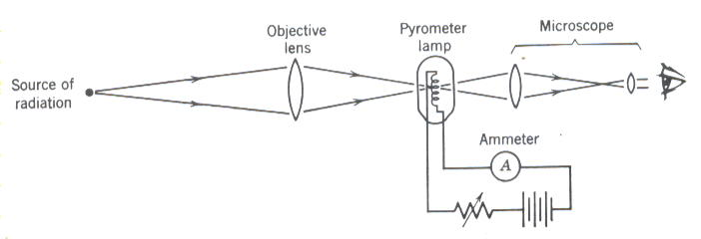
Chapter 1 Thermal radiation and Planck’s postulate
1.5 The use of Planck’s radiation law in thermometry
optical pyrometer
(1) For monochromatic radiation of wave length λ the ratio of the spectral
intensities emitted by sources at and is given by
standard temperature ( Au )
unknown temperature
(2) blackbody radiation supports the big-bang theory.

Slide 16
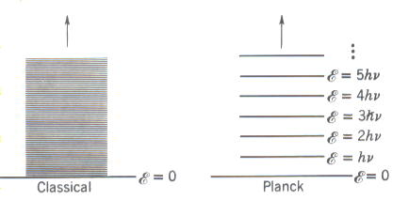
Chapter 1 Thermal radiation and Planck’s postulate
1.6 Planck’s Postulate and its implication
Planck’s postulate: Any physical entity with one degree of freedom whose
“coordinate” is a sinusoidal function of time
(i.e., simple harmonic oscillation can posses
only total energy
Ex: Find the discrete energy for a pendulum of mass 0.01 Kg suspended
by a string 0.01 m in length and extreme position at an angle 0.1 rad.
The discreteness in the energy is not so valid.

